Slide 1
How to Write a Paper
Or report, or Thesis, (or anything you like)
Peter Crowther
February 2019

Slide 2
Publication is required in Academia
Progress reports
Students are often required to produce annual progress reports
Technical Documents
Non-students are required to write technical documents and project proposals
Thesis
A report of all you have done in your studies
Journals
Dissemination of research results

Slide 3
Writing is hard
Collection of data
Planning of Manuscript
Initial draft
Collaborative improvements/editing
Publication
Here we focus on the improvements/editing section which often takes the most time of any of these steps (aside from data collection!)

Slide 4
Common problems when writing

Slide 5
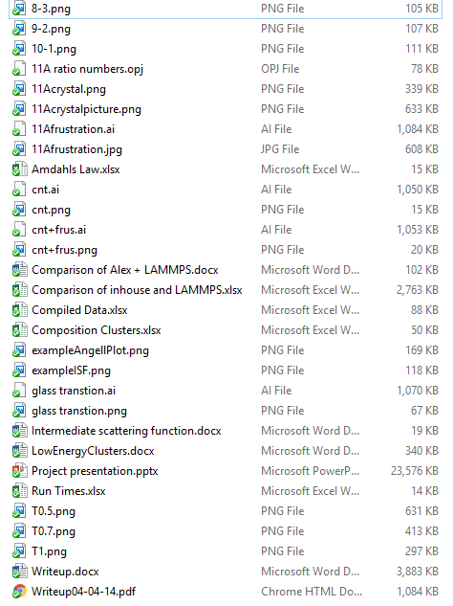
Organization

Slide 6
Organisation
Where has file XYZ gone?
What does something.important.doc do?
Where did the data for that figure go?

Slide 7
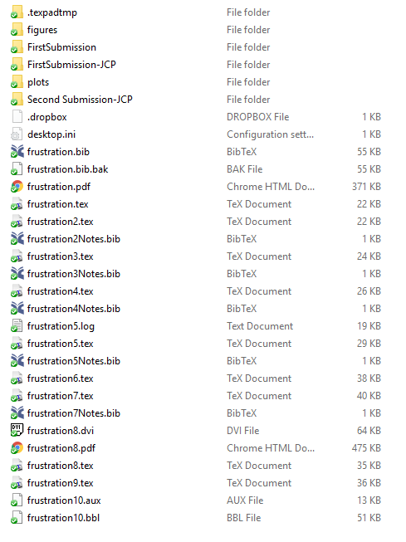
Version Control

Slide 8
Version Control
How can I keep an old version?
How can I collaborate with other authors?
How can I work across multiple machines?

Slide 9
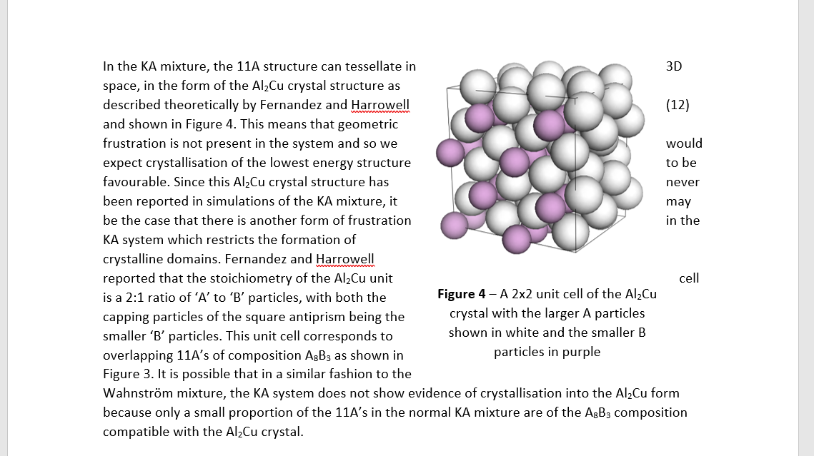
Typesetting

Slide 10
Typesetting
Why wont this stupid figure align with the text?
Why is the kerning all off if I justify text?
Can’t I just fill in a template?
Can I make it pretty without spending forever?

Slide 11
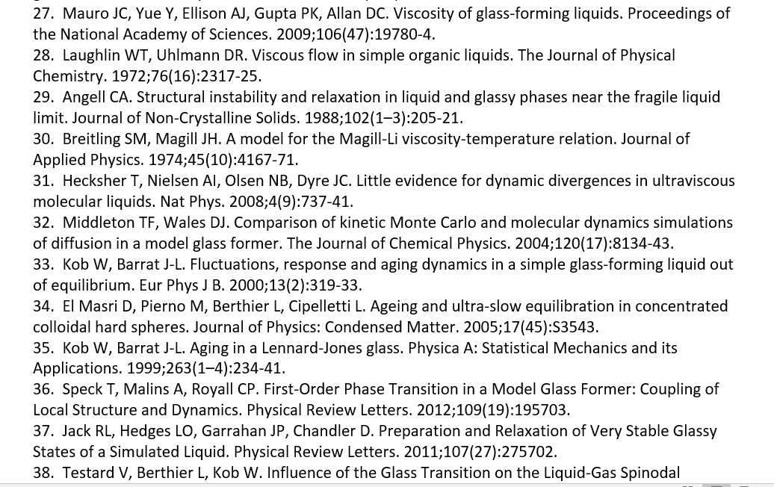
Citations

Slide 12
Citations
How can I speed up collection of citations?
How can I automate citations in my work?
What if my Journal needs a different format?
How can I keep track of all of my citations easily?

Slide 13
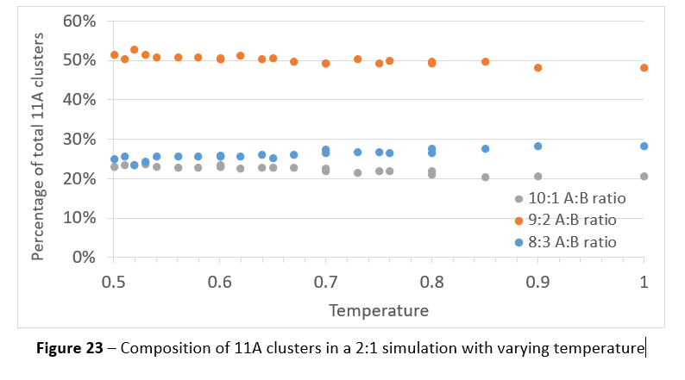
Figures

Slide 14
Figures
How can I make professional looking figures?
How can I make small updates without redoing the figures?
How can I keep my data closer to my figures?

